Slide 1
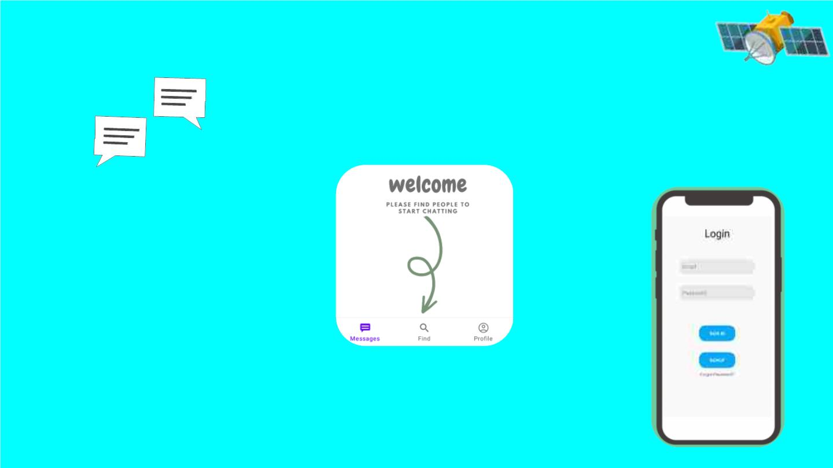
BuddyUp
A Internship Project by C.SaiAnjan
At Exposys Data Labs
Full Stack Developer

Slide 2
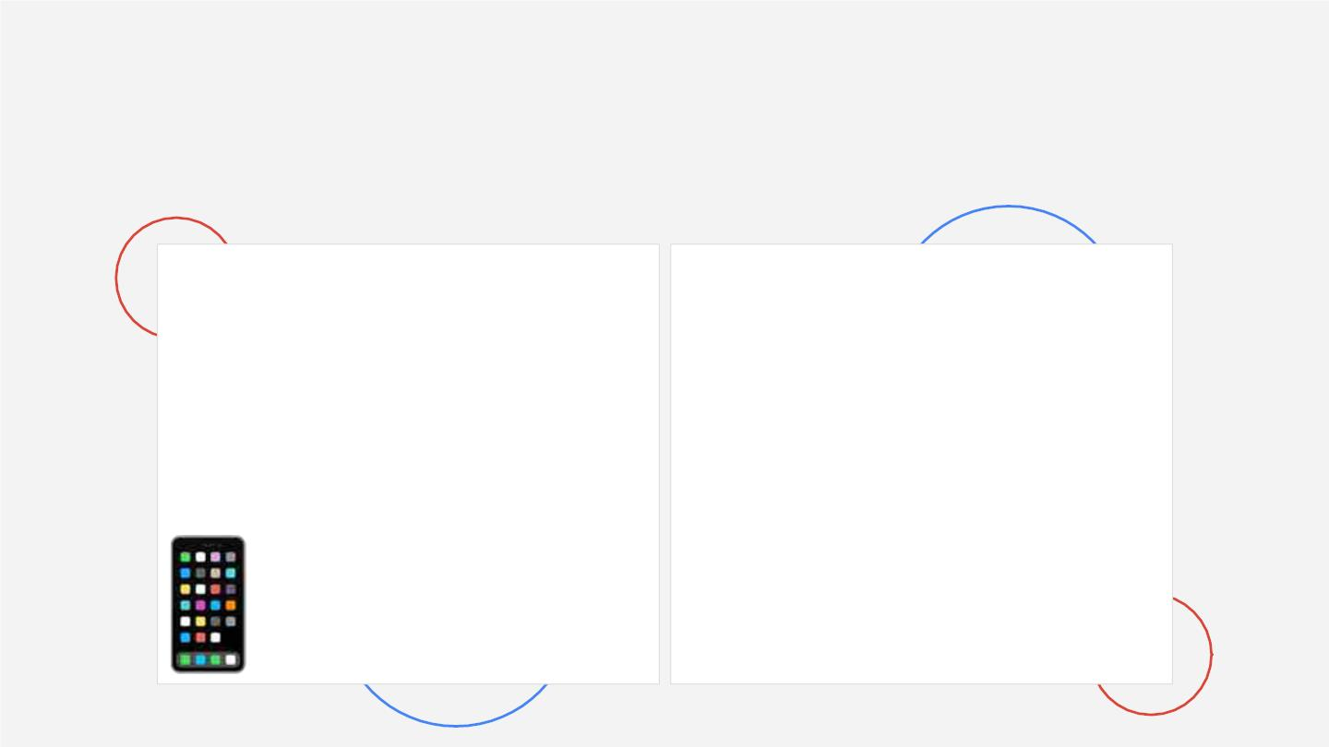
Project Details
Application details:
Features:
● App Title:BuddyUp
● Platform:Android
● Programing Language:Java
● Find new People with similar
Interests.
● Can Say Hello and send
messages to People.
● The App uses Firebase and
data can be accessed at all
time.

Slide 3

What is a Chatting?
Chatting refers to the process of
communicating, interacting and/or
exchanging messages over the Internet.

Slide 4

What is a Chat Application?
Chat Application is a program with which Users can communicate
directly with other Users on the Internet who are online through the
Internet.
With Chat Application Users can communicate with anyone, at
anytime and anywhere.
BuddyUp is an Chat application built in Android Studio for android
devices.

Slide 5

Android Studio
Android Studio is the official integrated
development environment for Google's
Android operating system, built on
JetBrains' IntelliJ IDEA software and
designed specifically for Android
development. It is available for
download on Windows, macOS and
Linux based operating systems.

Slide 6
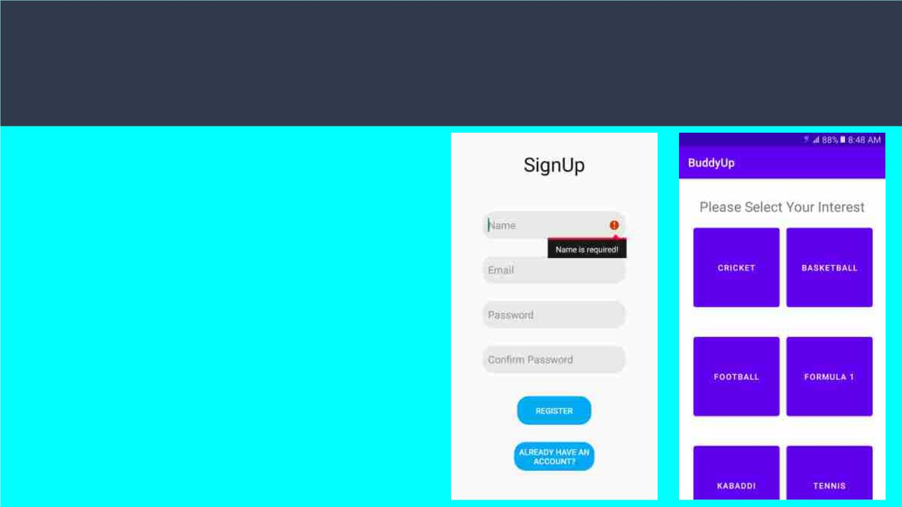
BuddyUp App
BuddyUp App first requires
an account for user to
access the app and the
messages in the app.
After Signing up the user has
to select their Interest and
then can find people and
start chatting with their
friends.

Slide 7
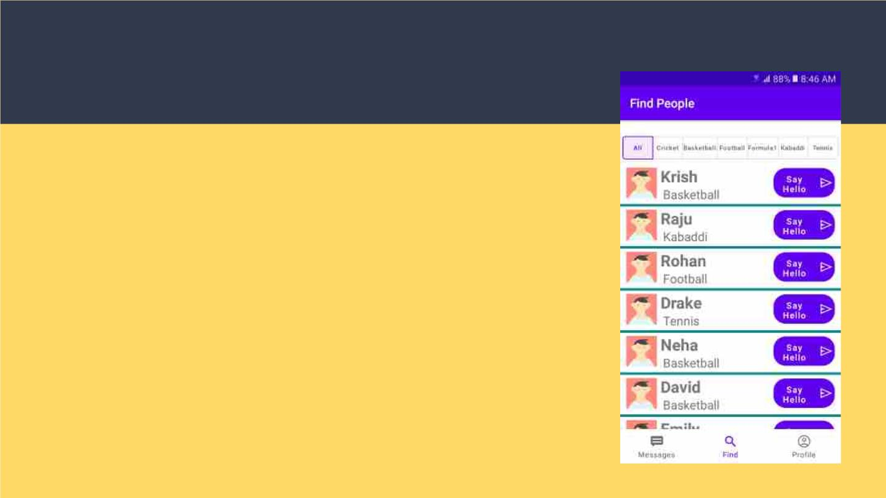
Features of BuddyUp
The main feature of the App is that you can find People
with common interests and send them a Hello request.
After finding People with common interests and
sending Hello request Users can Chat and send
Messages to each other through the App.

Slide 8

Conclusion
It has been a wonderful experience building this App. Many
more features can be added this App like last seen,changing
profile picture and message delivered time etc.
Thank you for giving me this great opportunity.

Slide 9

Thank You

